Slide 1

WEAPON DETECTION SYSTEM
Computer Vision based, Real-Time, Gun and Knife detector
PAUL CHARLES
AVNI MEHTA
RAJI MUPPALA
ERICH THOMPSON

Slide 2

WHAT?
The Weapon Detection system captures live video from Wi-Fi enabled cameras and determines the possibility of a gun or a knife in the scene using computer vision algorithms.
The system allows an administrator to monitor the cameras and analyze the activity logs via web.
When the system detects a weapon, the administrator will be immediately alerted with a text message.

Slide 3
WHY?
Economical
Early detection
Cutting-edge technology
Robust dataset
Enhanced performance
78% Accuracy
72% Precision
100% Recall

Slide 4
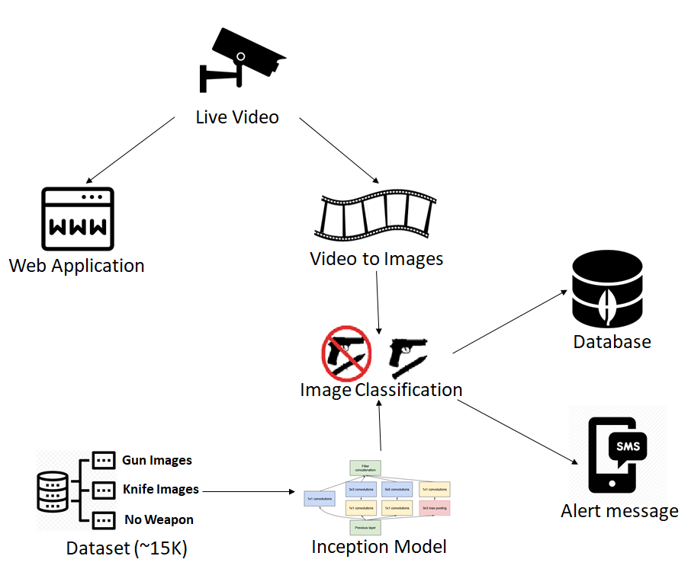






HOW?

